Slide 1
Advancing Reproducible and Secure Workflows for Autonomous Science at Scale
RAFAEL FERREIRA DA SILVA
GROUP LEADER NATIONAL CENTER FOR COMPUTATIONAL SCIENCES
Notes:
Image - 2022-P04822: Frontier supercomputer earned the top ranking May 2022, taken June 1, 2022. ORNLs Frontier supercomputer earned the top ranking Monday as the world’s fastest on the 59th TOP500 list, with 1.1 exaflops of performance. The system is the first to achieve an unprecedented level of computing performance known as exascale, a threshold of a quintillion calculations per second. This image has been reviewed by an ORNL Releasing Official and is approved for public release, August 9, 2022.

Slide 2
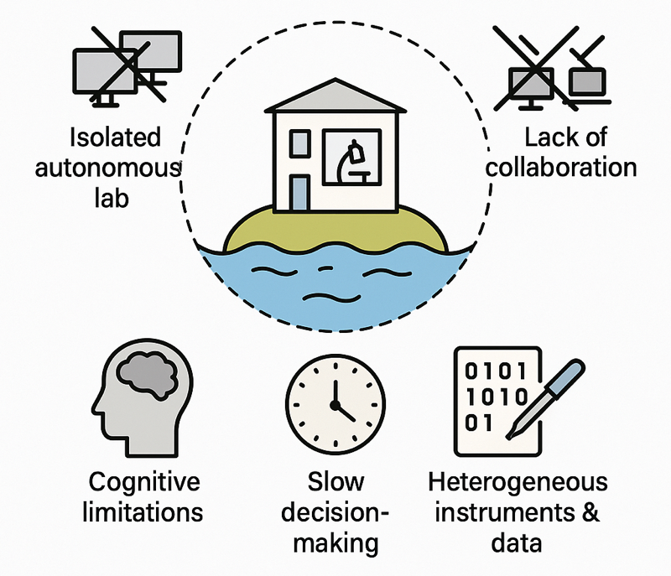
Motivation
https://autonomousscience.org
Current Autonomous Labs
Isolated Islands
Lack of cross-institutional collaboration & interoperability
Bottlenecks:
– Human cognitive limitations
– Slow decision-making cycles
– Heterogeneous instruments & data
Result: Slowed progress toward addressing urgent global challenges

Slide 3
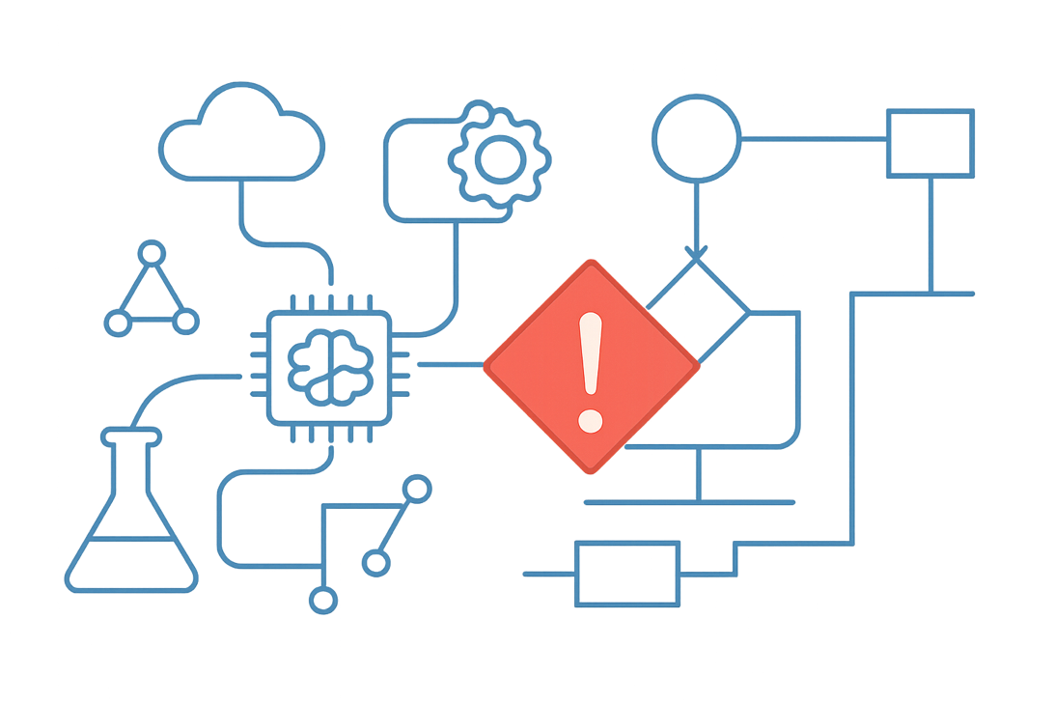
Challenges
https://autonomousscience.org
Workflows are Evolving
Modern discovery spans HPC, edge, instruments, and AI
Coordination is manual and slow
Reproducibility, interoperability, and security are major barriers
There is then a need for trust, adaptive decision-making, and transparent provenance across facilities

Slide 4
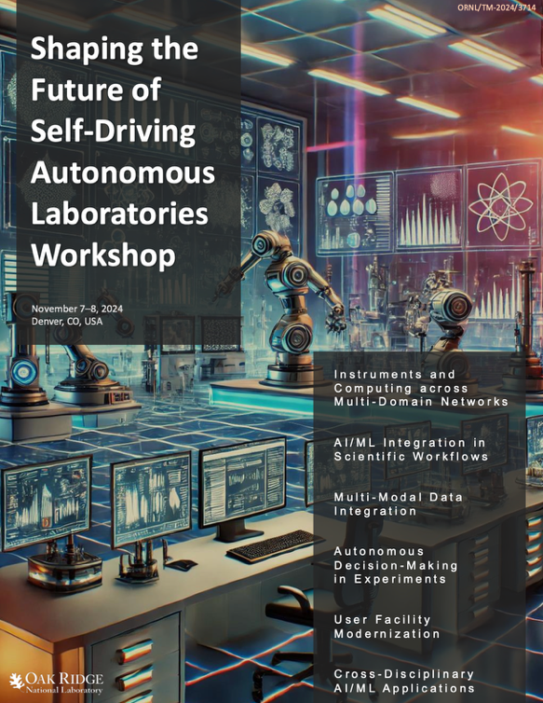

Next-Generation Scientific Labs
INTEGRATE AI WITH SCIENTIFIC METHOD
- Develop hybrid AI systems that combine data-driven learning with scientific principles
- Address critical timescale mismatch between human and machine operations
BUILD CONNECTED INFRASTRUCTURE
- Establish standardized cross-facility protocols for data and authentication
- Create sustainable ecosystems spanning instruments and computing systems
ENSURE SCIENTIFIC RIGOR
- Transform workforce development by integrating AI/ML with domain expertise
- Maintain essential human insight while leveraging automation
Shaping the Future of Self-Driving Autonomous Laboratories Workshop
Workshop Report – November 7-8, 2024
https://doi.org/10.5281/zenodo.14588062

Slide 5
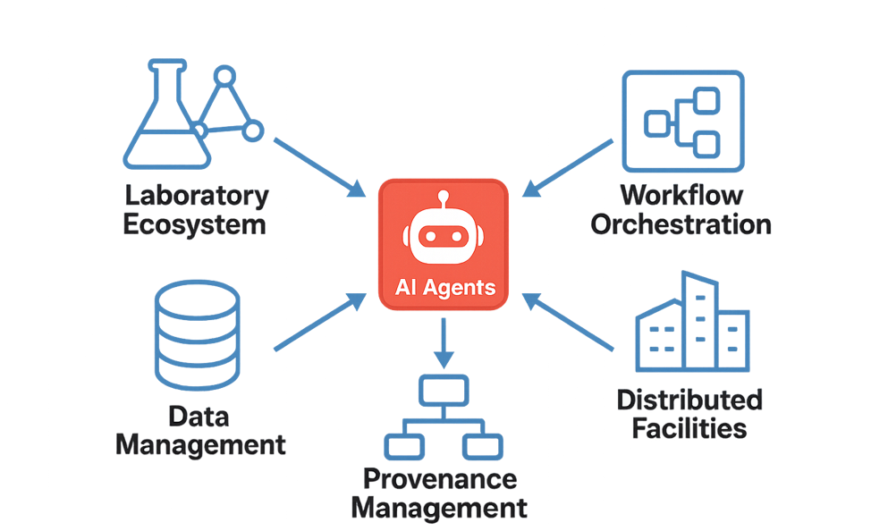
Vision for Autonomous Science
https://autonomousscience.org
From static workflows to intelligent, agent-driven systems
Continuous, closed-loop experimentation integrating HPC, AI, and instruments
Accelerate discovery cycles from years to months while ensuring reproducibility and openness

Slide 6
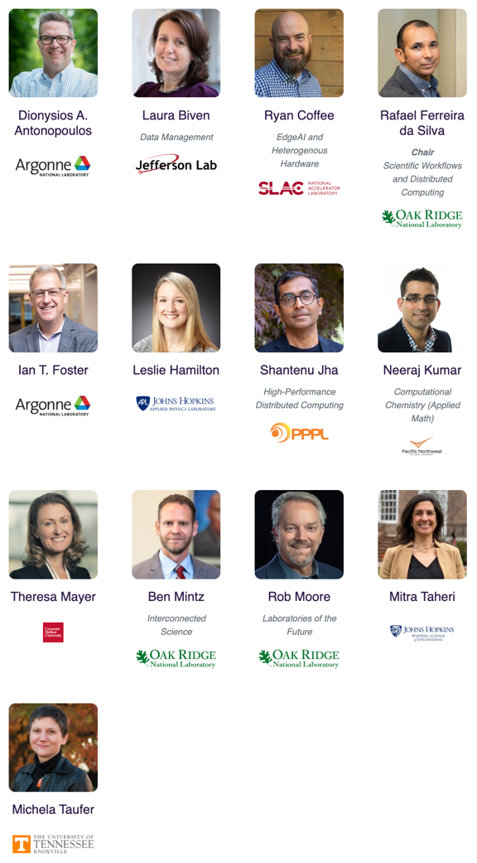

What is AISLE?
Autonomous Interconnected Science Lab Ecosystem
GRASSROOTS NETWORK ENABLING CROSS-INSTITUTIONAL LAB COLLABORATION
AI agents orchestrate experiments, data, and instruments
Democratizes access to scientific tools and shortens discovery cycles
Goal: From siloed automation → collaborative autonomous science
Collaborative Steering Council

Slide 7
The Five Pillars of AISLE
https://autonomousscience.org
INTEGRATING DIVERSE COMPUTING PARADIGMS
- HPC + AI/ML + Quantum working in harmony
- Seamless resource sharing across facilities
- Automated workflow optimization and steering
KEY TRANSFORMATIONS
- From manual orchestration to autonomous operation
- From single-facility to distributed execution
- From batch processing to near real-time response
CRITICAL NEEDS
- Standardized protocols for cross-facility integration
- Dynamic resource management for hybrid workflows
- Unified authentication and data movement standards
Agents: orchestrators linking experiments, computation, and data.

Slide 8
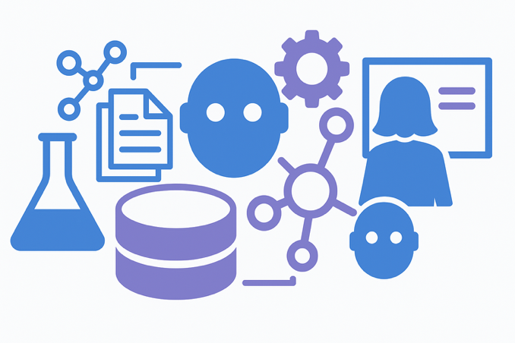

Dimensions
https://autonomousscience.org
Instruments & CI Integration
Orchestrate diverse scientific instruments across facilities
Enable cross-institutional workflows and real-time data flows
Agent-Driven Data Management
Autonomous agents curate, validate, and enforce FAIR principles
Federated “data mesh” for sharing across institutions
AI Agent-Driven Orchestration
LLM-based agents coordinate experiments with ML/physics models
Combine Bayesian optimization, RL, and uncertainty quantification
Interoperable Communication
Standardized, vendor-agnostic protocols and ontologies
Secure, asynchronous, and scalable multi-agent coordination
Education & Workforce Development
Train scientists for human–AI collaboration
Interdisciplinary curricula with AI/ML, robotics, and ethics

Slide 9
Key Technical Milestones (1)
https://autonomousscience.org
M1: Common integration interfaces and vendor-agnostic APIs
Create a standardized Instrument API via a national consortium to interface with diverse equipment from multiple vendors
Promote plug-and-play interoperability across labs and reduce integration overhead
M5: AI-driven metadata annotation systems
Develop agents that understand experimental context and autonomously tag data with semantic metadata
Minimize manual curation and enable near real-time data enrichment at source
M2: End-to-end autonomous workflows across institutions
Demonstrate secure orchestration of multi-site workflows connecting experimental and computational resources
Use federated CI with zero-trust security and coordinated scheduling
M6: Federated data mesh for FAIR-compliant governance
Establish common APIs for cross-institutional data discovery and compliance
Support automated policy enforcement for data sharing, privacy, and access control

Slide 10
Key Technical Milestones (2)
https://autonomousscience.org
M8: Hierarchical agent orchestration
Design multi-layer agent systems where LLMs coordinate domain-specific methods (e.g., Bayesian optimization, RL)
Achieve measurable improvements in efficiency and correctness, verified with physics-based constraints
M12: Self-discovering agents with dynamic reconfiguration
Implement DNS-based service discovery and registries that allow agents to detect capabilities and adapt behavior in near real-time
Enable resilience to changes in network topologies and agent availability
M10: Containerized agent microservices
Package scientific agents as microservices using standard communication protocols (gRPC, AMQP)
Deploy across DOE labs with federated identity management for secure multi-agent coordination
M13: National education consortium for autonomous labs
Launch collaborative programs integrating AI, robotics, and science curricula across NSF and DOE institutes
Include immersive virtual lab environments and new assessment models for human-AI teaming

Slide 11

Call to Action
https://autonomousscience.org
Join the AISLE movement to shape the future of science
TRANSFORMING DISCOVERY
Reducing timelines from decades to months
Unlocking previously inaccessible scientific spaces
Enabling integration across DOE, NSF, and academic programs
Promoting equitable participation in AI-driven science
CALL TO ACTION
Develop open APIs, ontologies, and communication protocols
Help define secure, vendor-agnostic integration frameworks
Collaborate on cross-institution workflows and digital twins
Test AI agents, data meshes, and orchestration frameworks in real-world labs
Help design immersive curricula and competency assessments

Slide 12
So, how do we actually make (some of) this happen?

Slide 13
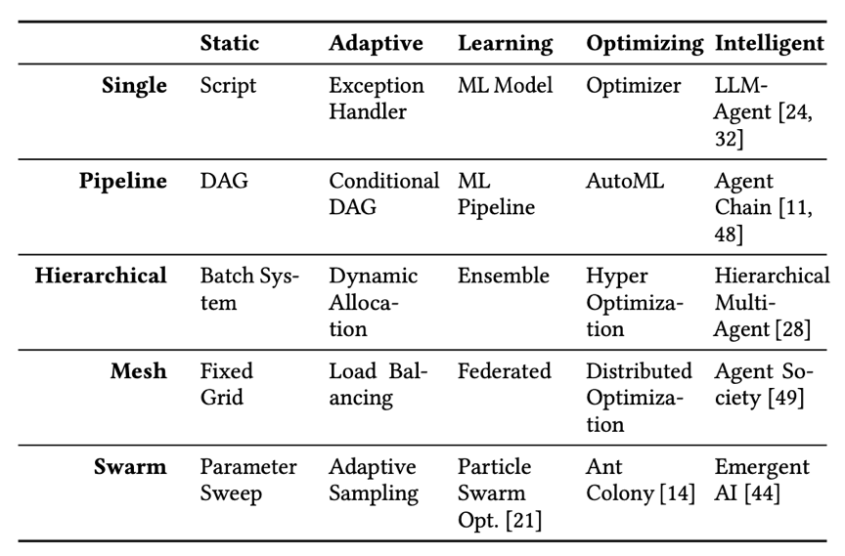
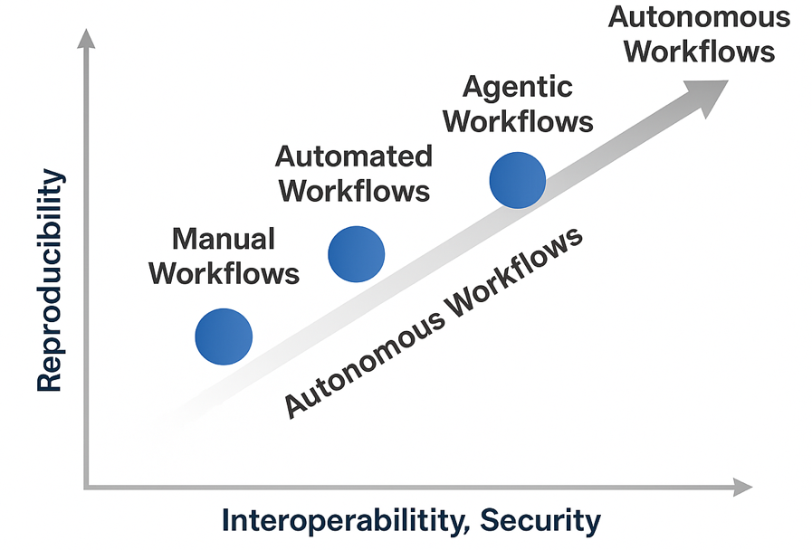

Evolutionary Framework
https://autonomousscience.org
Shin, W., Souza, R., Rosendo, D., Suter, F., Wang, F., Balaprakash, P., & Ferreira da Silva, R. (2025). The (R)evolution of Scientific Workflows in the Agentic AI Era: Towards Autonomous Science.
20th Workshop on Workflows in Support of Large-Scale Science (WORKS).
Monday, November 17, 2025 – SC25

Slide 14
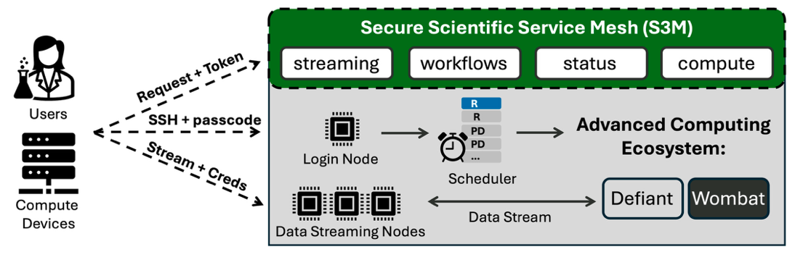

Secure Scientific Service Mesh (S3M)
S3M LAYER BUILT UPON A K8S-BASED OPENSHIFT SYSTEM AND ISTIO SERVICE MESH
- Sits between third-party systems and protected resources
- Decoupled service layer from HPC systems
- Enables secure, monitor, customizable, and scalable service interfaces in support of autonomous science
SECURITY-FIRST MINDSET
- Provides a central service that is capable of enforcing policy, logging, authenticating, authorizing, and securing all income API requests to a range of target systems
Skluzacek, T. J., Bryant, P., Ruckman, A. J., Rosendo, D., Prentice, S., Brim, M. J., Adamson, R., Oral, S., Shankar, M., & Ferreira da Silva, R. (2025). Secure API-Driven Research Automation to Accelerate Scientific Discovery. PEARC ’25: Practice and Experience in Advanced Research Computing

Slide 15
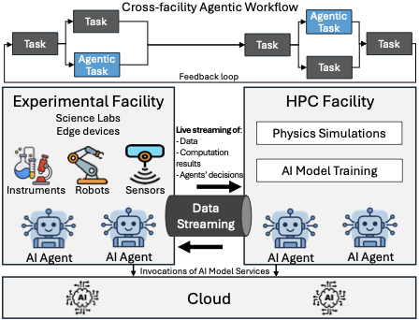
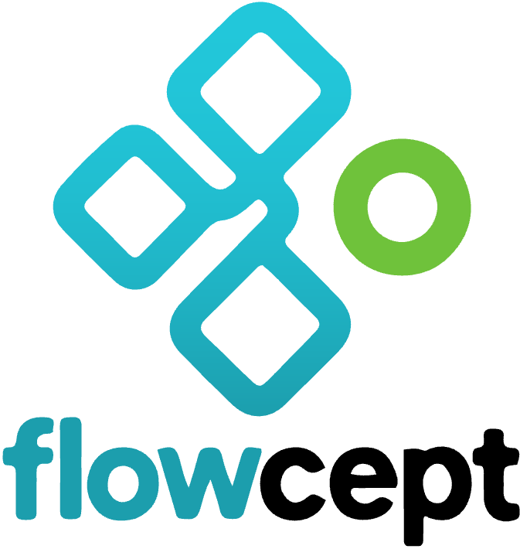
Flowcept: Unified Workflow Provenance Data Management
See Renan Souza’s talk at 4:30pm today!
PROV-AGENT: Unified Provenance for Tracking AI Agent Interactions in Agentic Workflows
https://github.com/ORNL/flowcept

Slide 16
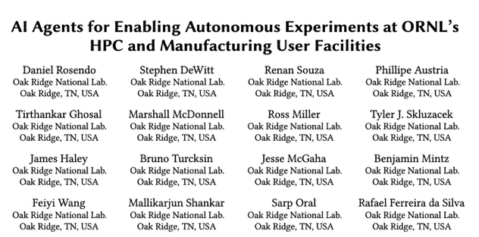

An Example Agentic Workflow: MDF and OLCF
https://autonomousscience.org

Slide 17
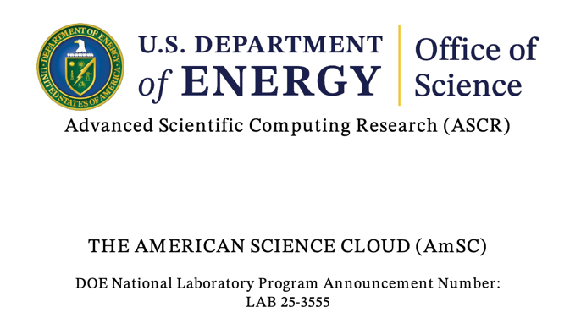
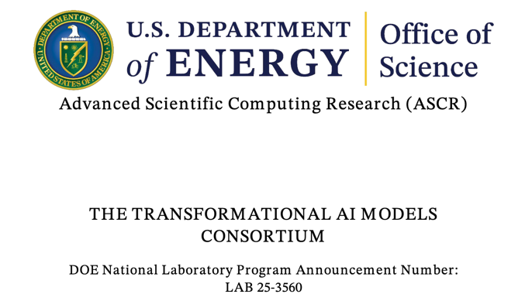
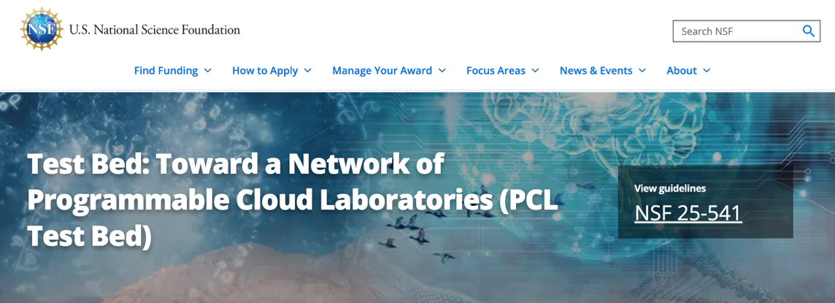
U.S. Federal Solicitations

Slide 18

Join Us at SC25
https://autonomousscience.org
BIRDS OF A FEATHER SESSIONS
WORKFLOWS COMMUNITY Bridging Intelligent Workflows with Quantum and HPC for Scientific Discovery
Tuesday - Nov 18, 2025 12:15pm—1:15pm CT (Expected)
https://workflows.community/bof/sc25/
AUTONOMOUS SCIENCE NETWORK Interconnected Autonomous Science Labs Empowered by HPC and Intelligent Agents
Wednesday - Nov 19, 2025 12:15pm—1:15pm CT (Expected)
RESEARCH PAPERS
XLOOP 2025
AI Agents for Enabling Autonomous Experiments at ORNL's HPC and Manufacturing User Facilities
Rosendo, et al.
WORKS 2025
The (R)evolution of Scientific Workflows in the Agentic AI Era: Towards Autonomous Science
Shin, et al.
LLM Agents for Interactive Workflow Provenance: Reference Architecture and Evaluation Methodology
Souza, et al.

Slide 19
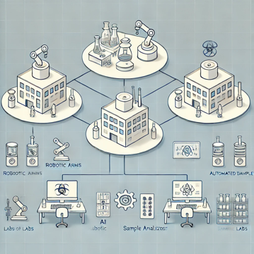
HPC, CLOUD, EDGE, QUANTUM
HIGH-SPEED NETWORKS
AUTONOMOUS
SCIENCE
INSTRUMENTS, TESTBEDS

Slide 20
FEDERATED IDENTITY
HPC, CLOUD, EDGE, QUANTUM
HIGH-SPEED NETWORKS
AUTONOMOUS
SCIENCE
FACILITIES API
FEDERATED POLICIES
INSTRUMENTS, TESTBEDS

Slide 21
HIGH PERFORMANCE DATA MANAGEMENT
Adaptive reduction
FEDERATED IDENTITY
ENRICHED PROVENANCE & METADATA
WORKFLOW BENCHMARKS
Responsible AI
Streaming, AI, Edge-Cloud-HPC Continuum
HPC, CLOUD, EDGE, QUANTUM
HIGH-SPEED NETWORKS
AUTONOMOUS
SCIENCE
FACILITIES API
FAIR WORKFLOW COMPONENTS
FEDERATED POLICIES
INTER-AGENCY
COLLABORATION
Sharing and
interoperability
INSTRUMENTS, TESTBEDS
Collaborative & Community-driven Science
DISTRIBUTED SERVICES
ORCHESTRATION
FEDERATED LEARNING
Collaborative Systems
AGENTIC AI
Privacy preserving workflows
Workflows for Self-Discovery

Slide 22
HIGH PERFORMANCE DATA MANAGEMENT
USERS & SCIENTIFIC RESULTS
Adaptive reduction
FEDERATED IDENTITY
ENRICHED PROVENANCE & METADATA
WORKFLOW BENCHMARKS
Responsible AI
Streaming, AI, Edge-Cloud-HPC Continuum
HPC, CLOUD, EDGE, QUANTUM
HIGH-SPEED NETWORKS
AUTONOMOUS
SCIENCE
FACILITIES API
FAIR WORKFLOW COMPONENTS
FEDERATED POLICIES
INTER-AGENCY
COLLABORATION
Sharing and
interoperability
INSTRUMENTS, TESTBEDS
Collaborative & Community-driven Science
DISTRIBUTED SERVICES
ORCHESTRATION
FEDERATED LEARNING
Collaborative Systems
AGENTIC AI
Privacy preserving workflows
Workflows for Self-Discovery

Slide 23

Thank You!
Questions?
Rafael Ferreira da Silva
Group Leader / Senior Research Scientist
Workflow and Ecosystem Services Group
National Center for Computational Sciences
This research used resources of the Oak Ridge Leadership Computing Facility, which is a DOE Office of Science User Facility supported under Contract DE-AC05-00OR22725.
https://rafaelsilva.com

